Slide 1
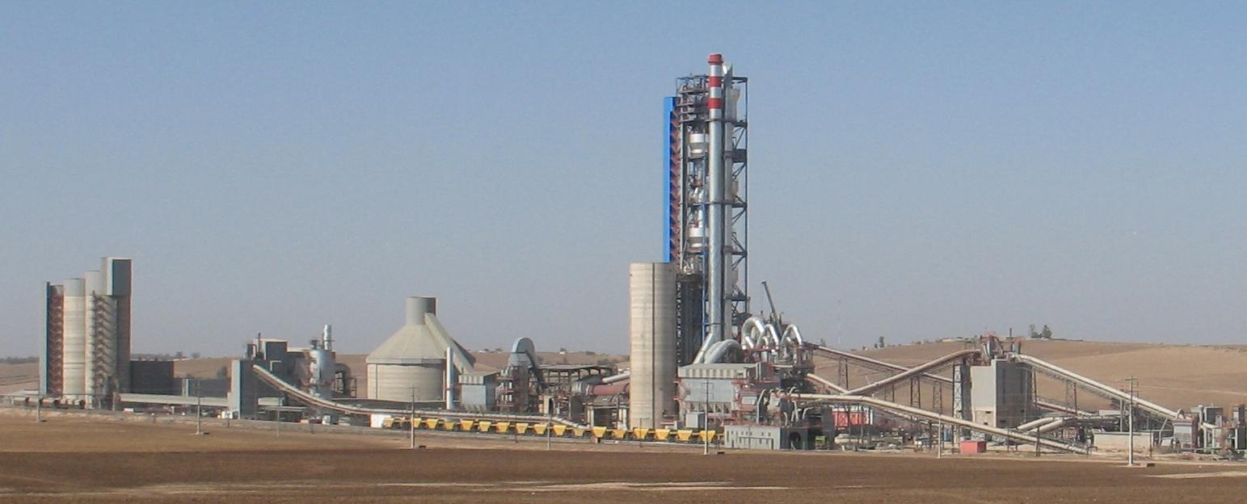
Plant visit – AFR Installations
SPREAD Course 2016, Settat, Sorin Petrescu - Geocycle

Slide 2
Timing / Organization 1/2
23.05.2016 / 15:30 – 17:30 Change of Post every 40 min.
Post 1 (R.El Hamraoui) - Liquid AF (waste water, used oils) + Solid AF feed points in preheater (calciner)
Post 2 (A.Hamdani) - Solid AF (shredded tires, fluff) - all activities from ground floor
Post 3 (M.Motich) - Central Control Room and Lab
Group 1 P1→P2→P3 15:30→16:10→16:50
Group 2 P2→P3→P1 15:30→16:10→16:50
Group 3 P3→P1→P2 15:30→16:10→16:50

Slide 3
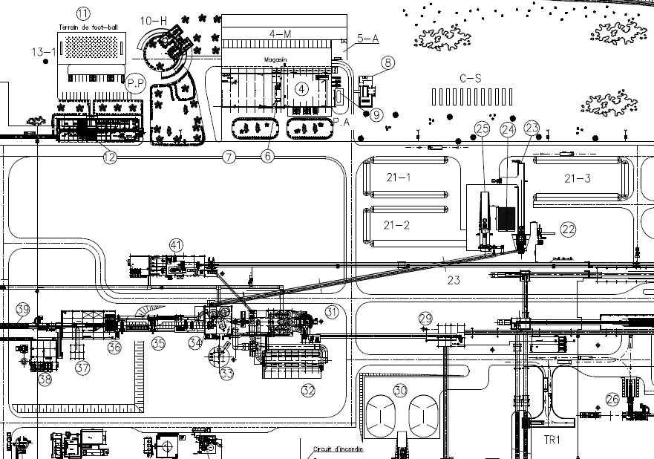
Timing / Organization 2/2
Post 3 CCR and Lab
Change point
Post 2: Solid AF installation
Post 1: Liquid AF installation

Slide 4

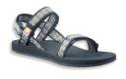
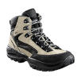


Important !!
Please do not touch anything!
Wear always helmet, eye protection and high visibility vest!
Wear solid footwear!
Do not cross the railways!
Stay with your group, do not
explore!
Please do not smoke!
Any questions?
Please ask your group leader!

Slide 5
Important !!
No use of cell phones (calls / texting), except for taking pictures
Watch out for traffic / vehicles

Slide 6
Plant visit – Objectives
See and understand all AF feed systems and firing points
General highlights / limitations of feed systems / firing points → give feedback/observations
Detailed look at feed systems for solid AF
Being able to draw the flow-sheet
How is the feed rate controlled? What other controls are required to make the feeding work well?
Do you see bottlenecks regarding dosing stability & feed capacity?
How do you judge the AF quality?
How is the AF sampling done (RDF)
Suggestions for improvement?
Observe the kiln operation with AF in central control room
See the AF lab equipment and ask about the AFR control plan
Ask questions!

Slide 7
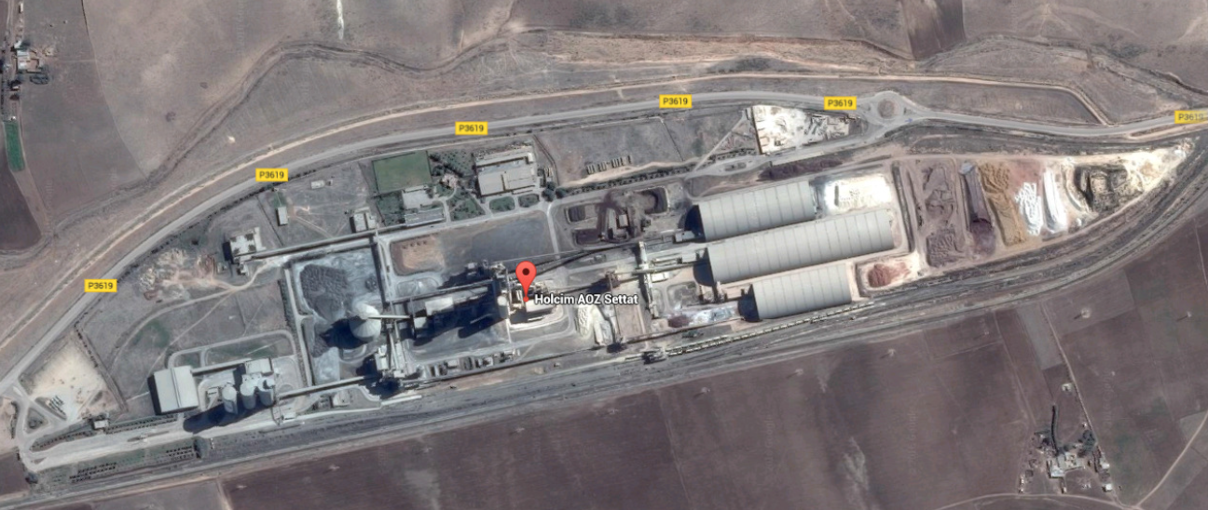
Settat Plant
Solid AF
Hall storage
Kiln
Packing station and bulk loading
Liquid AF

Slide 8
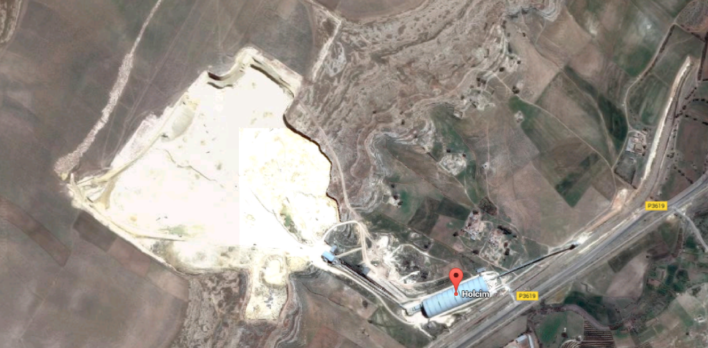
Limestone quarry

Slide 9
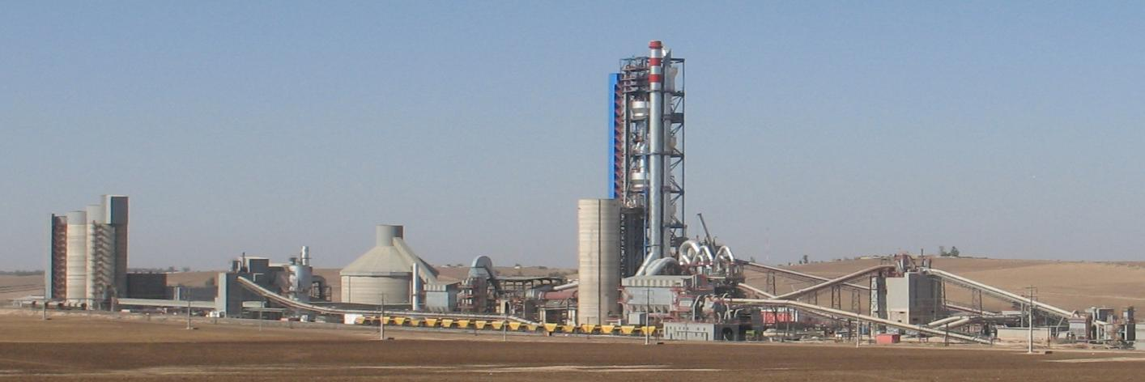
SETTAT PLANT
Kiln start-up 2007
Supplier: CBMI
Original design capacity: 4000 tpd (Clinker production 1,2MT)
Cement production 1,7MT
Calciner kiln, 5 stages
2 VRM (Raw et Cement Mills)

Slide 10
Kiln KPIs A2015
Kiln
BDP, t/d 4000
Feed, t/h 3946
PRI, % 98,7
NAI, % 93,0
GAI, % 77,1
MTBF, h 392
Energy
STEC, kJ/kg cli 3390
SEEC, kWh/t cem 72,1

Slide 11
AFR KPIs A2015 B2016
TSR, % 13,8 28,62
TEE, % 7,10
AF volume, t 25010 80214
TF cost, MAD/GJ 34,88
AF cost, MAD/GJ 14,64
AF cost, CHF/GJ 1,46
Fuel mix, %
Petcoke 86,0,8 71,22
Diesel 0,12 0,15
Shredded tires 9,60 15,46
SSW (fluff) 2,80 10,46
Olive Pomace 0,80 2,00
Used Oil 0,60 0,70
Waste Water (no CV) 0,00 0,00

Slide 12
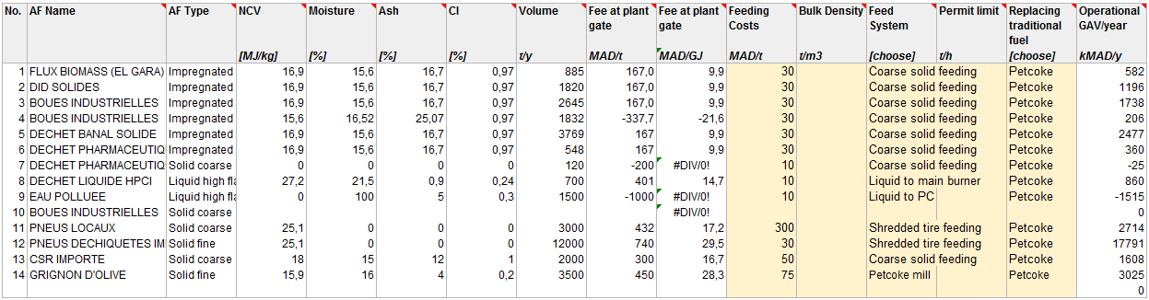
Development of AFR KPIs – Plant long term strategy

Slide 13
Pre-processing Platform Information
Waste | AF quantities delivered to plant (kt)
Year | 2013 | 2014 | 2015
Shredded tires | 19 465 | 15 652 | 13 125
SSW (fluff) | 6 577 | 6 211 | 8 080
Olive Pomace | - | - | 1 350
Used Oil | 1 215 | 1 330 | 754
Waste water | 753 | 1 681 | 1 689

Slide 14
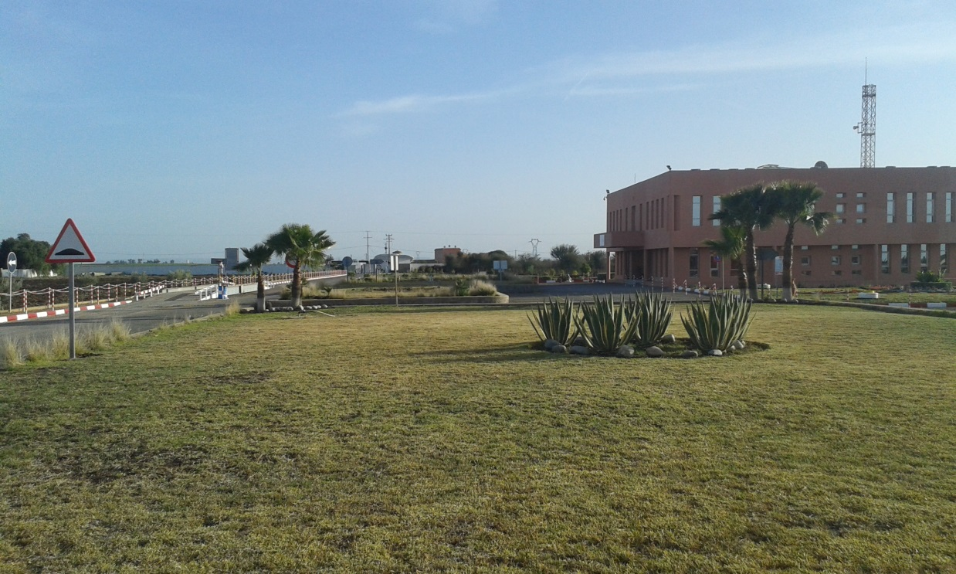
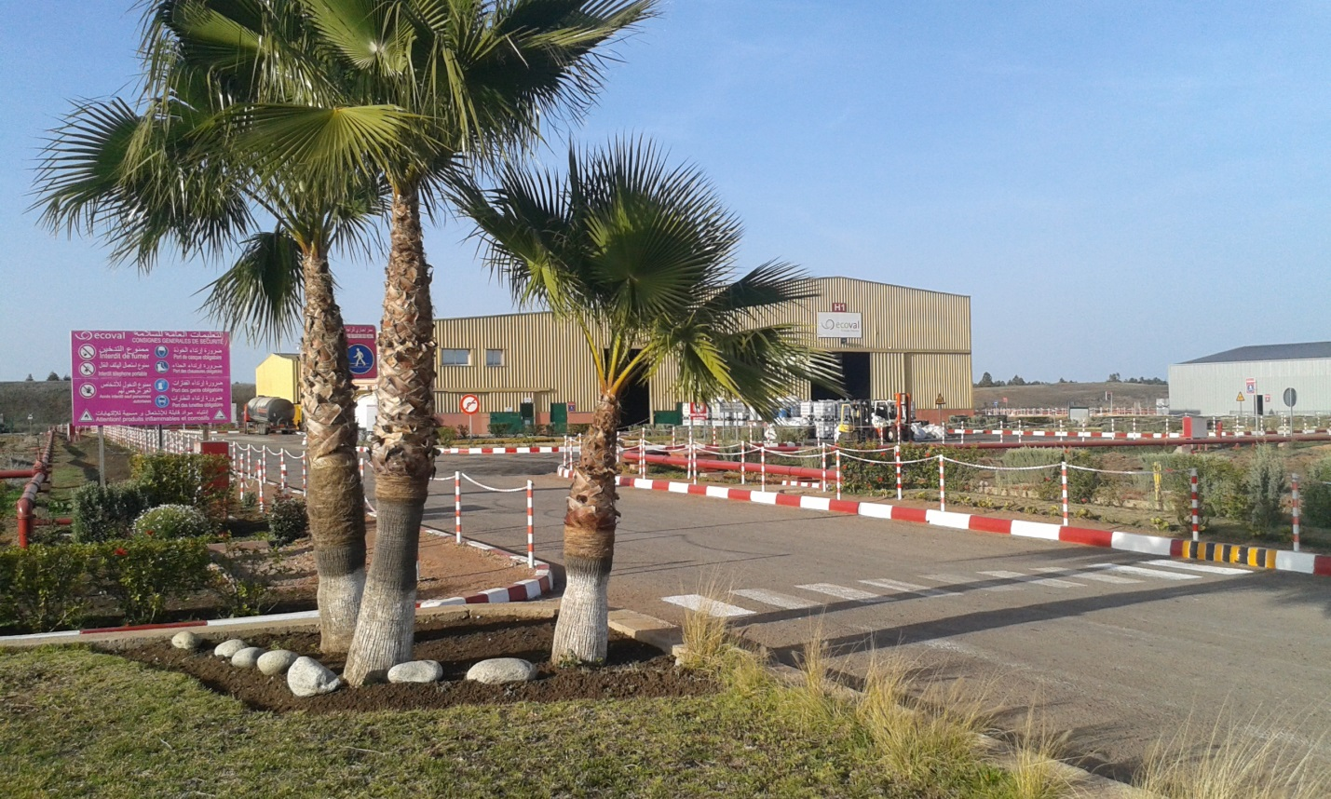
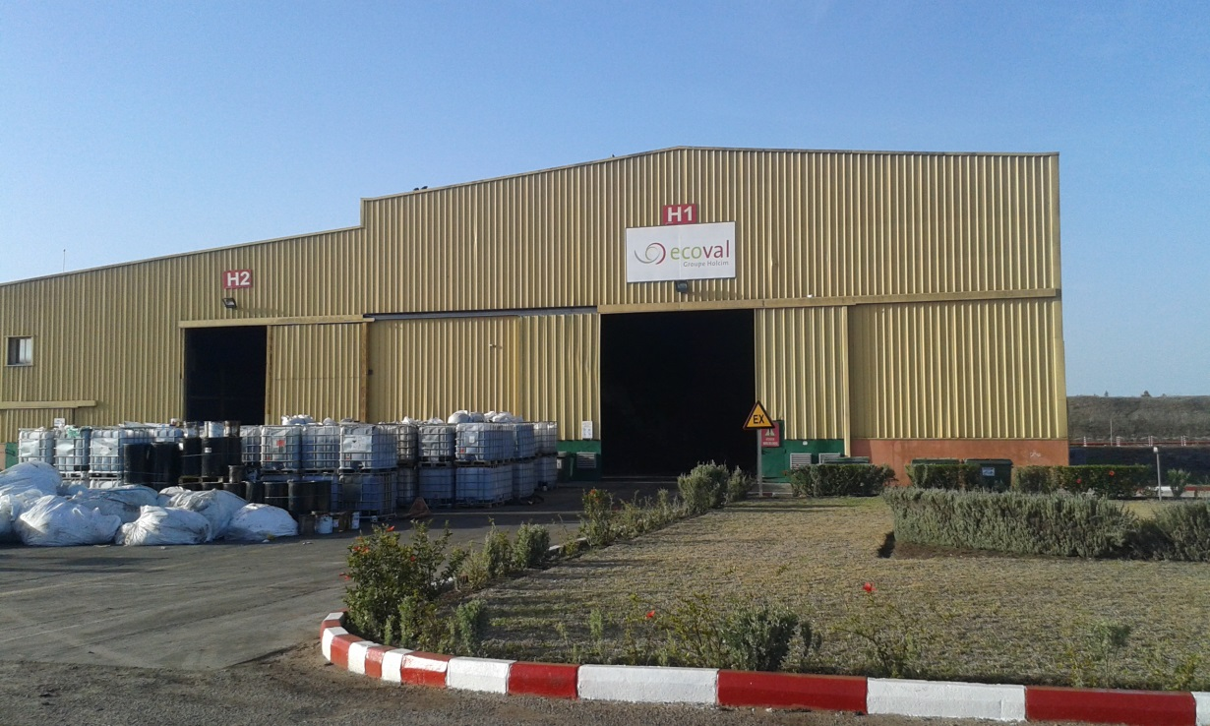
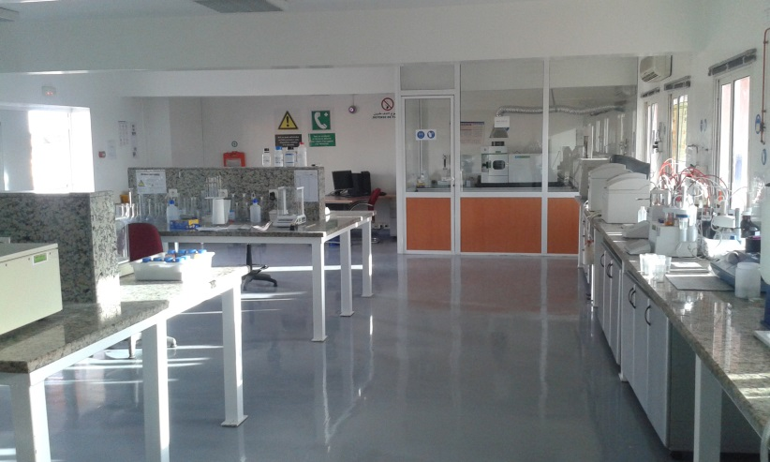
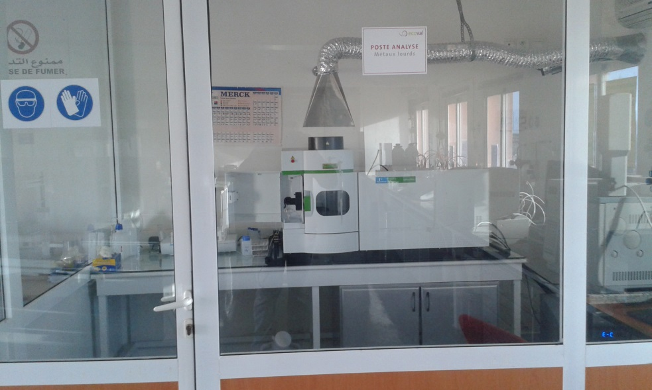
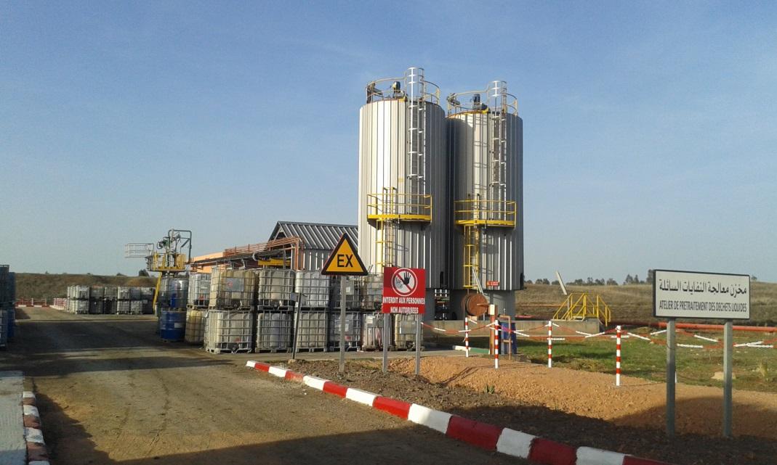
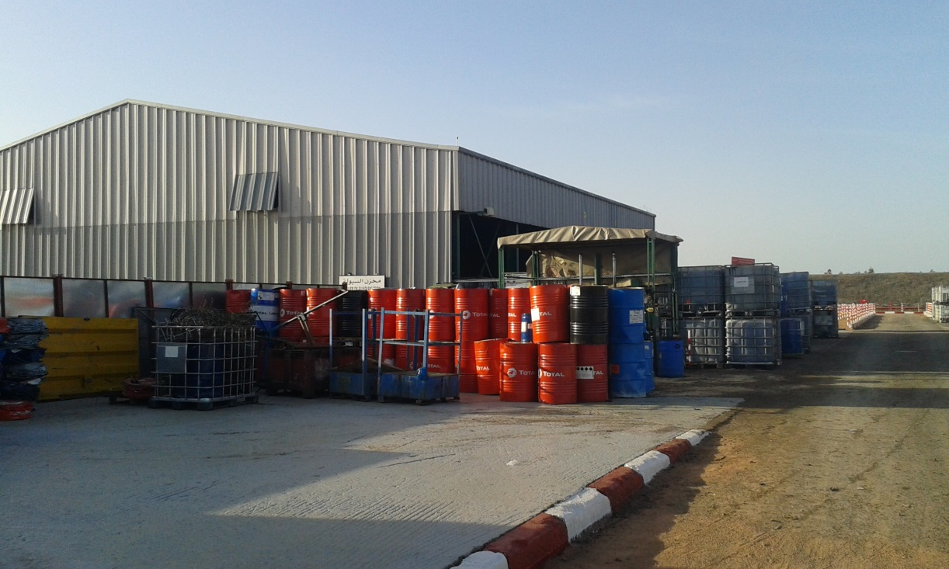
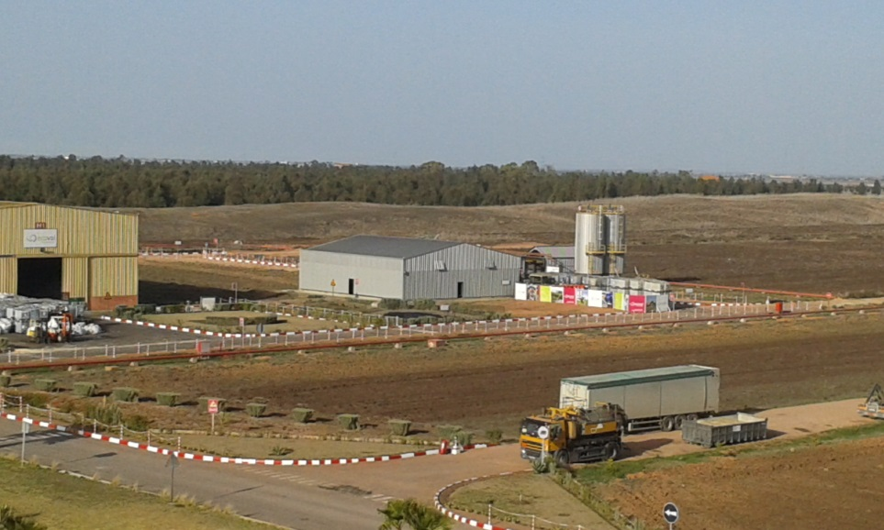
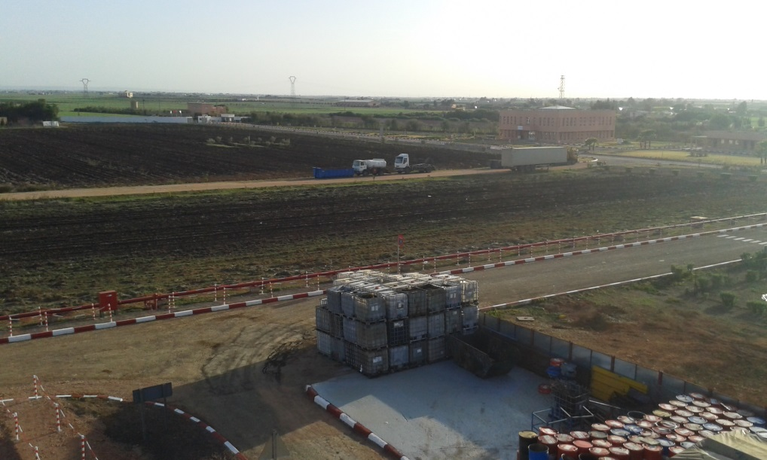
Plateforme Ecoval (Geocycle)

Slide 15
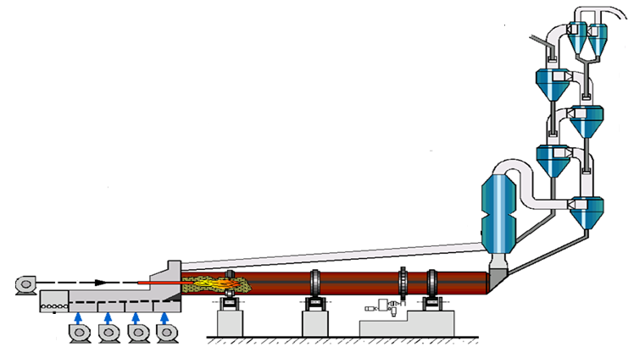
Feed Systems
Waste Water
Solid AF
Shredded tyres
Shredded plastics
SSW Ecoval
Used Oils

Slide 16
Feed System – Solid AF

Slide 17
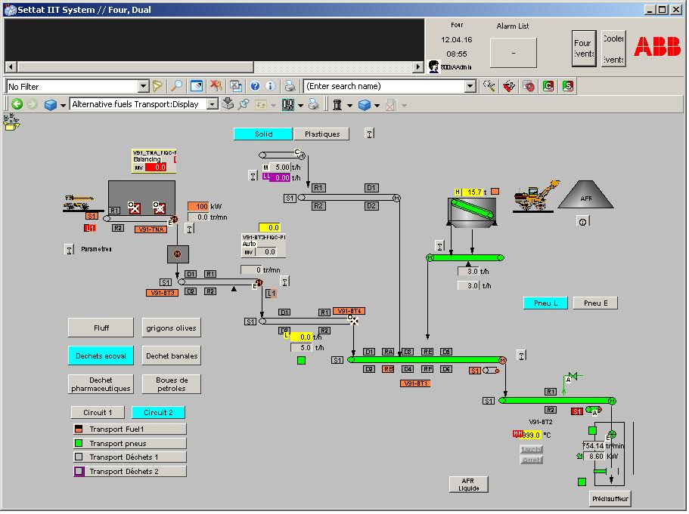
Feed System – Solid AF

Slide 18
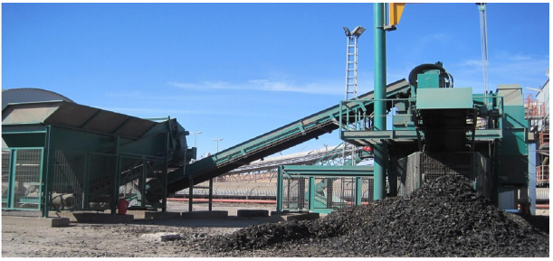
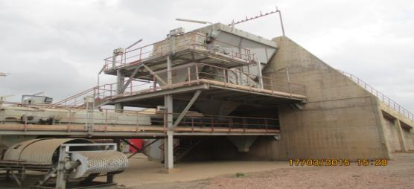
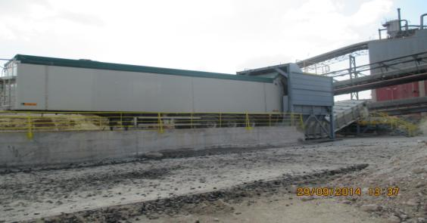
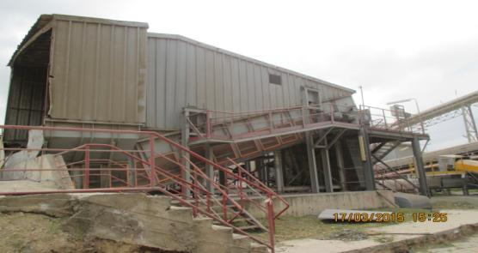
Solid AFR Installations
Solid AF
Tires shredder
Capacity : 5 tph tires PL, 7 tph tires VL ,
10 tph pre-shredded tires
Dosage of shredded tiress
Capacity : 10 tph
Docking station solid AF (Ecoval)
Capacity : 15 tph
Solid AF dosage (SAMSON)

Slide 19
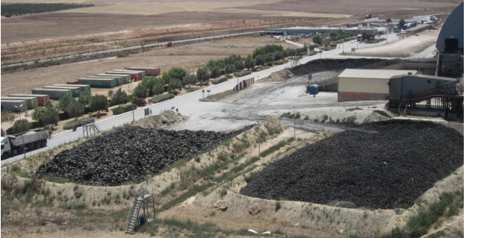
Solid AFR Installations
Storage of solid AF
3 storage areas for shredded tires and plastics
(approx 3000m2, 3500 t)
1 storage area for whole tires and rubber to be
Shredded (approx 1000m2, 500 t)
1 covered hall for solid AF (SSW) – 200 t

Slide 20
Feed System – Liquids

Slide 21
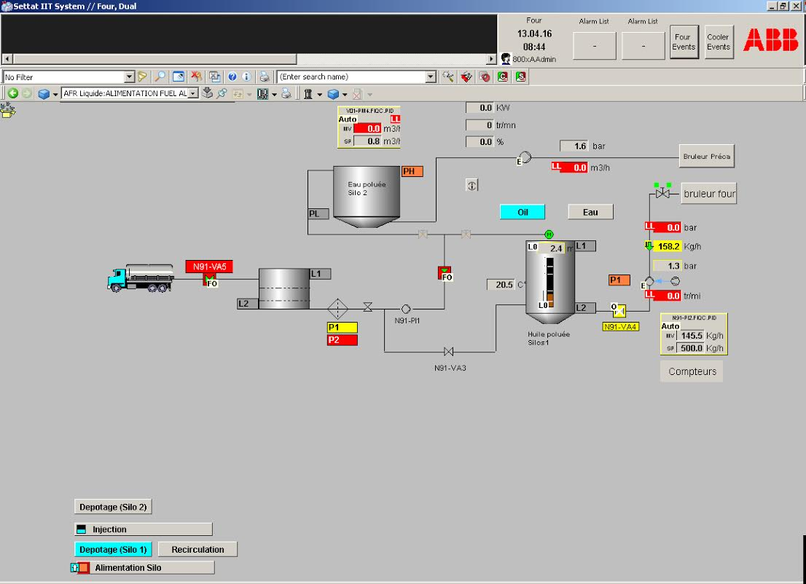
Feed System – Liquids

Slide 22
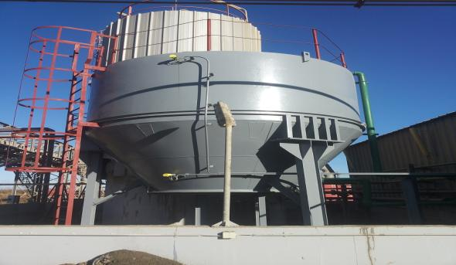
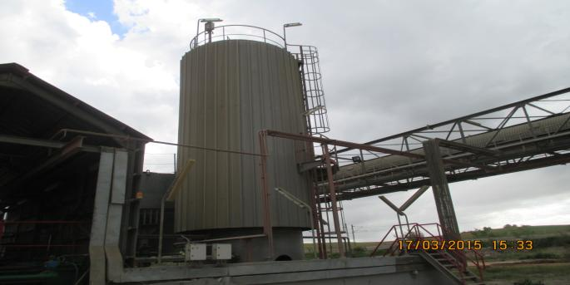
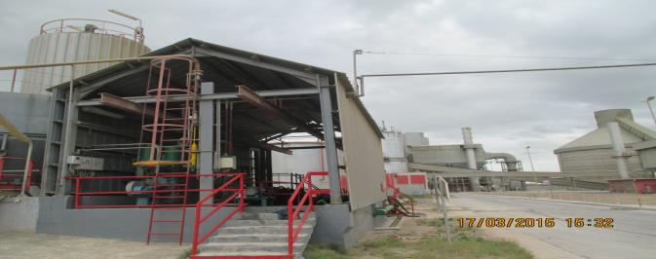
Liquid AFR Installations
Storage of waste/polluted water (30m3)
Storage of used oils (60m3)
Unloading station for liquid AF (2 tph used oils, 1 tph waste water)

Slide 23
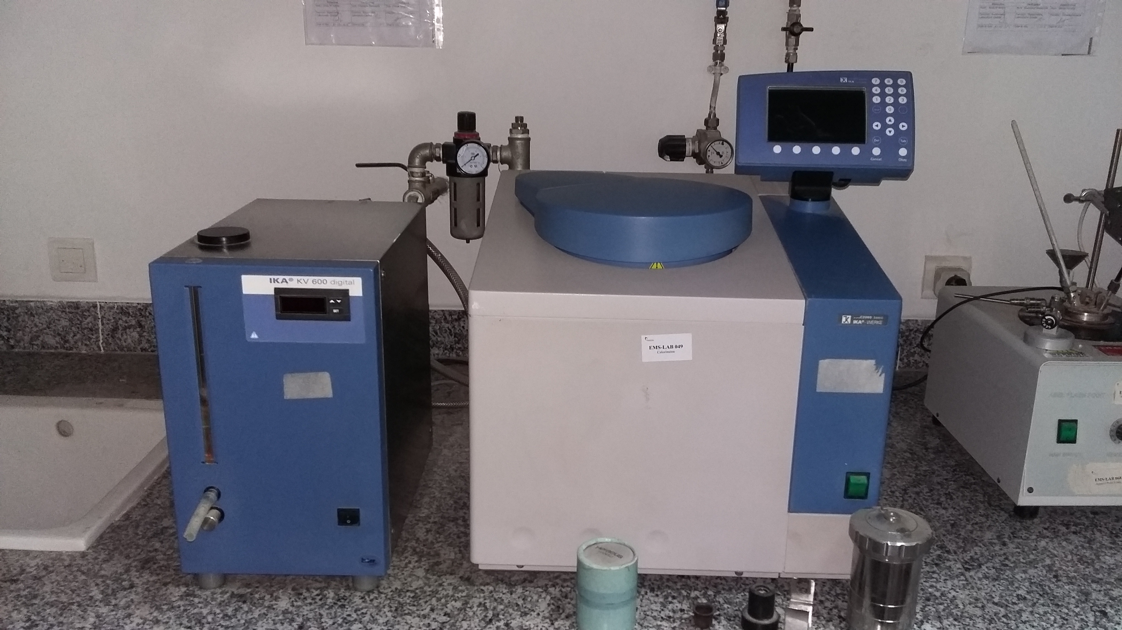
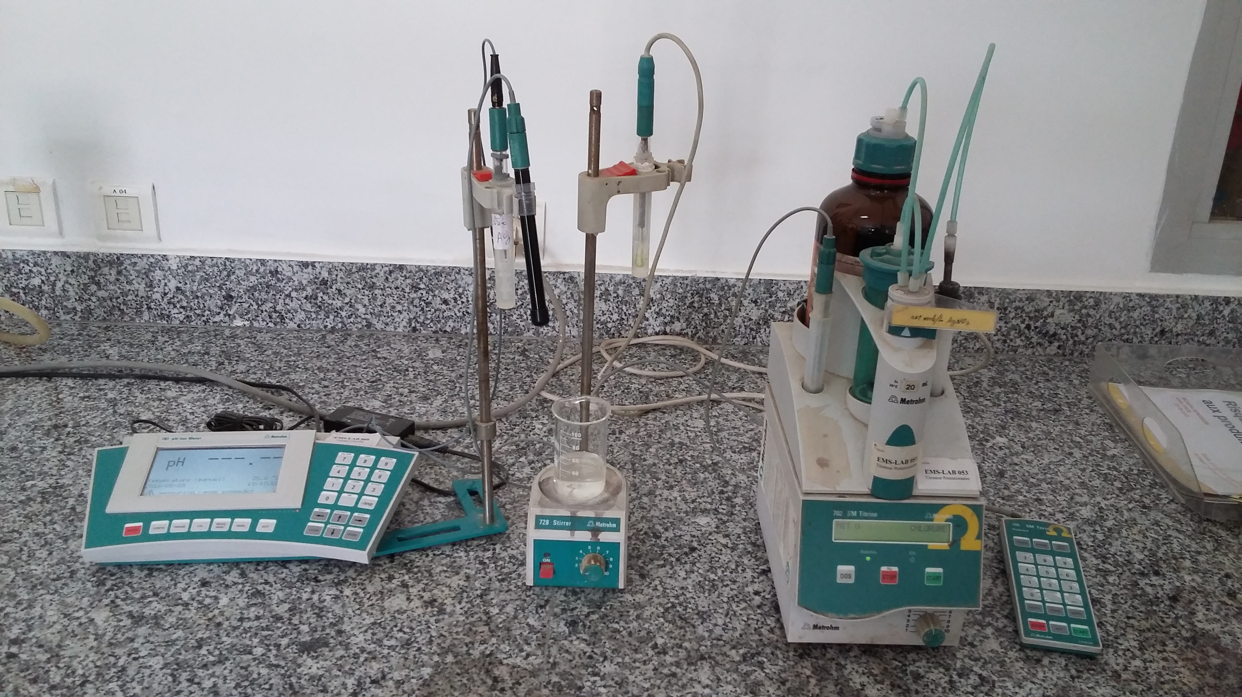
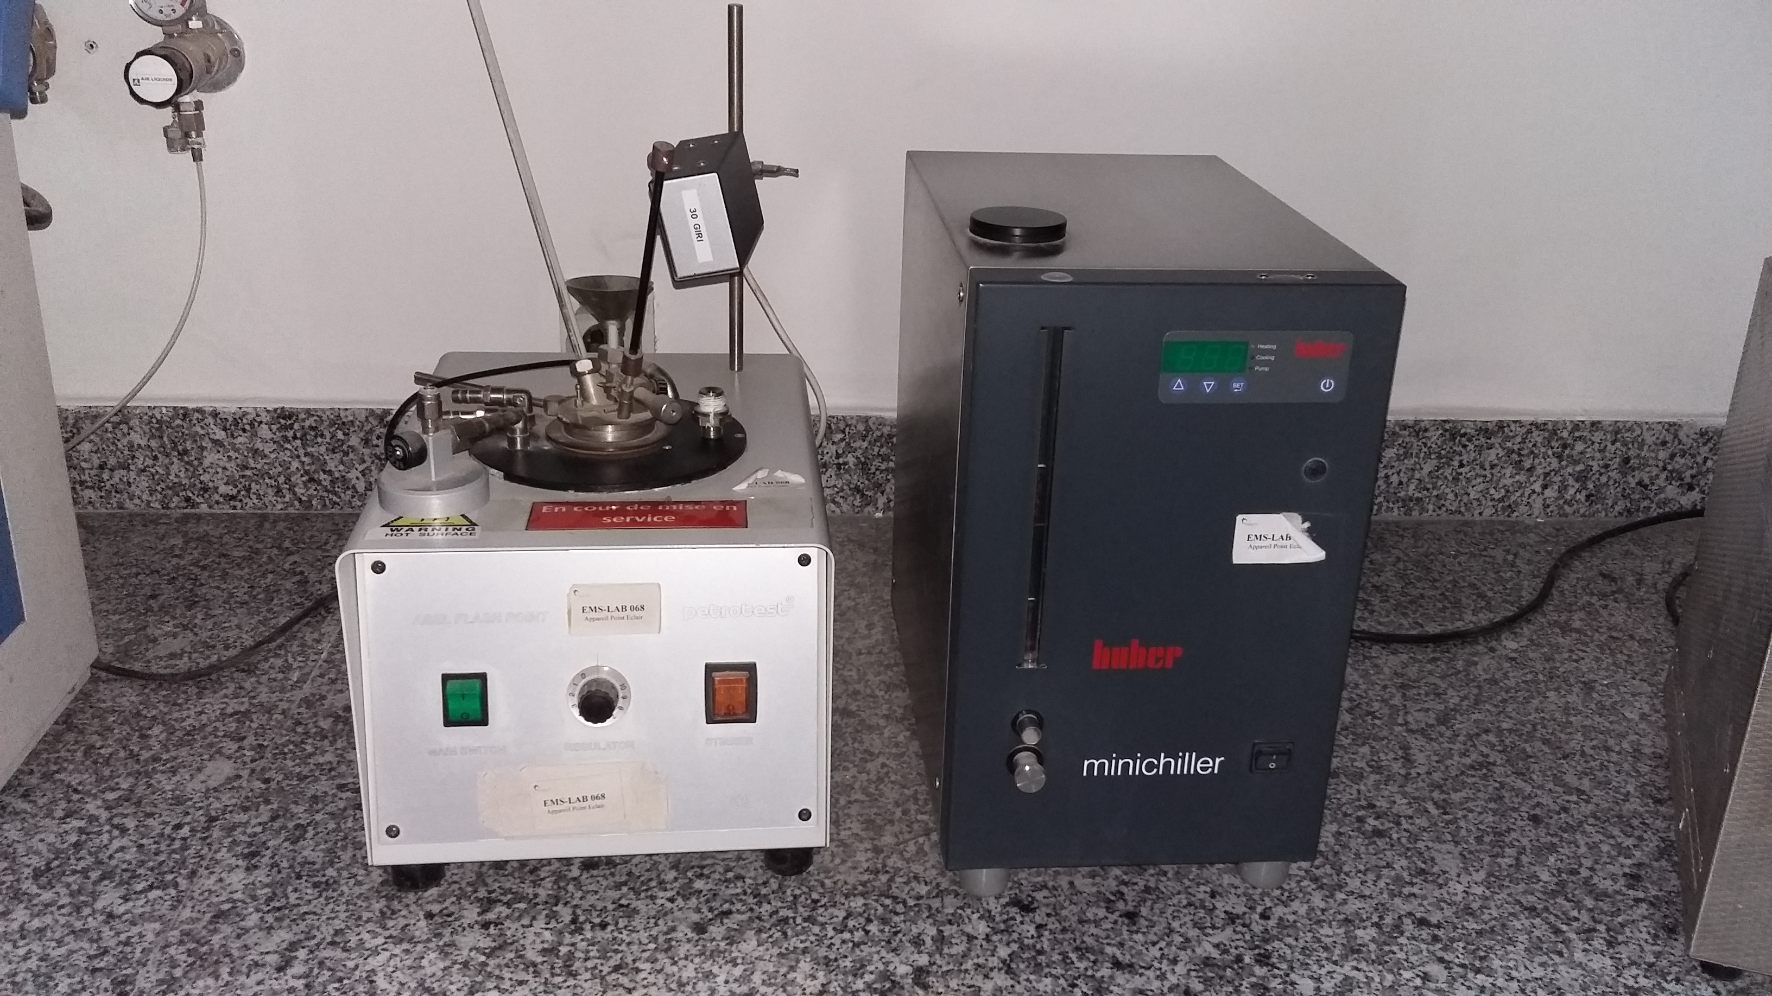
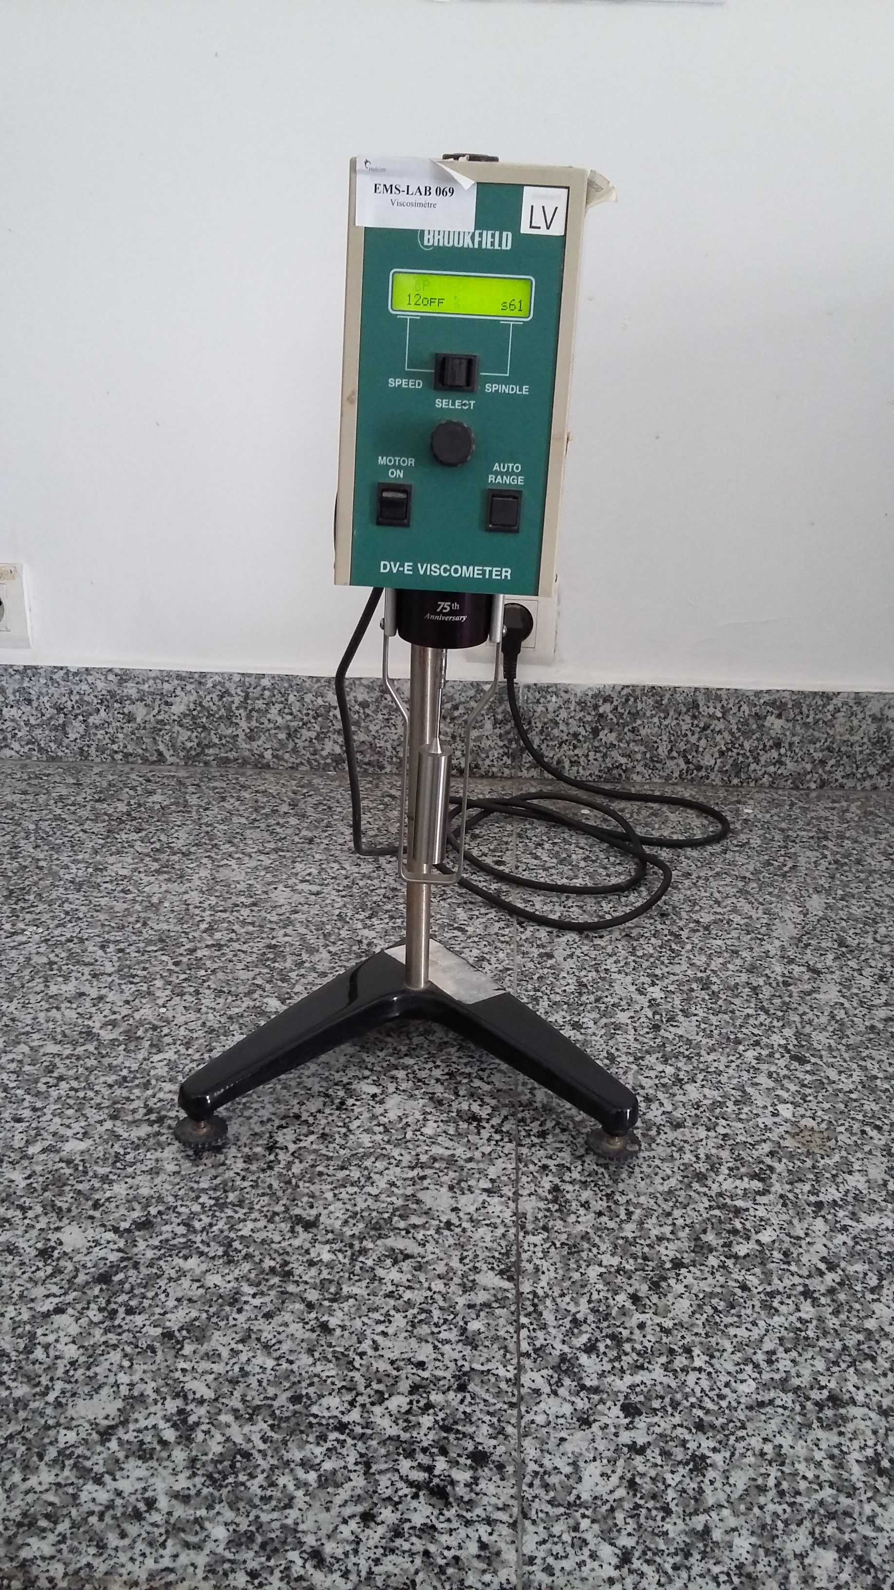
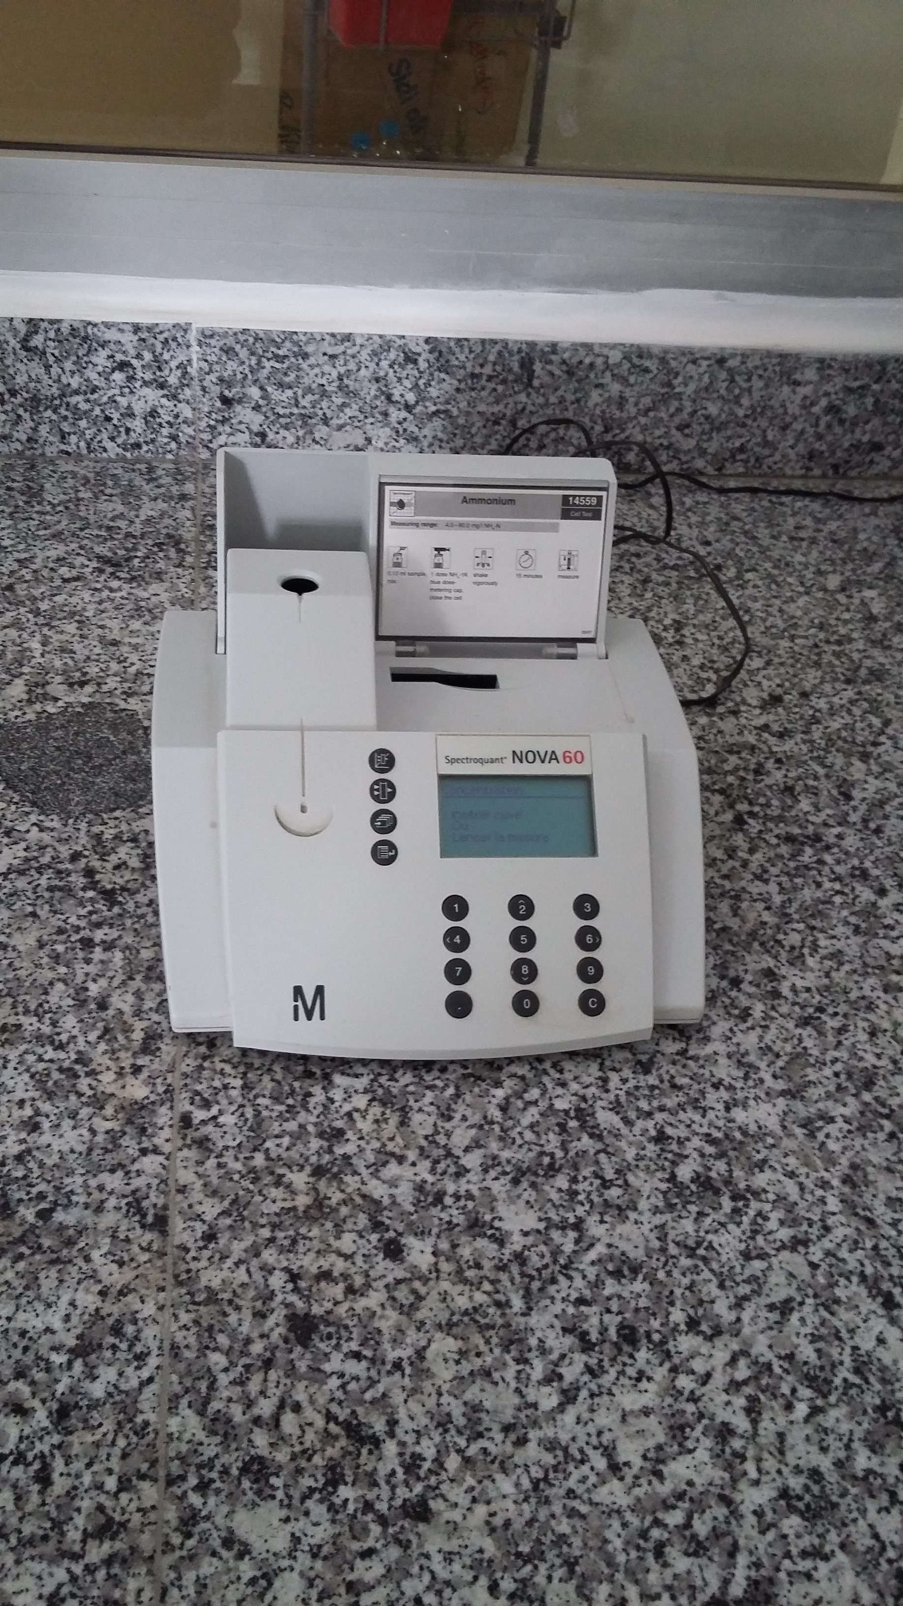
AF Lab
Calorimeter
Spectro-photomètre
Flash point
Viscosimeter
Potentiomètre for S and F

